Slide 1
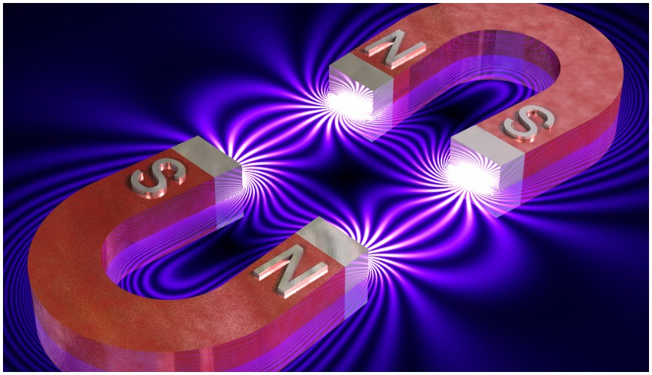


Slide 2
2.1. MAGNETIC FORCE AND MAGNETIC FIELD
2.1.1. Magnetic field lines
Magnetism is a class of physical phenomena that are mediated by magnetic fields. Electric currents and the magnetic moments of elementary particles give rise to a magnetic field, which acts on other currents and magnetic moments.

Slide 3
In our study of electricity, we described the interactions between charged objects in terms of electric fields. Recall that an electric field surrounds any electric charge. In addition to containing an electric field, the region of space surrounding any moving electric charge also contains a magnetic field. A magnetic field also surrounds a magnetic substance making up a permanent magnet.

Slide 4
Magnetic field lines
Historically, the symbol B has been used to represent a magnetic field, and we use this notation in this chapter. The direction of the magnetic field at any location is the direction in which a compass needle points at that location. As with the electric field, we can represent the magnetic field by means of drawings with magnetic field lines.

Slide 5
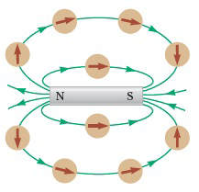
Compass needles can be used to trace the magnetic field lines in the region outside a bar magnet.
The figure shows how the magnetic field lines of a bar magnet can be traced with the aid of a compass
Notice that the magnetic field lines outside the magnet point away from the north pole and toward the south pole

Slide 6
Magnetic field at a point in space
We can quantify the magnetic field by using our model of a particle in a field, like the model discussed for gravity and for electricity. The existence of a magnetic field at some point in space can be determined by measuring the magnetic force exerted on an appropriate test particle placed at that point. This process is the same one we followed in defining the electric field in previous chapter. If we perform such an experiment by placing a particle with charge q in the magnetic field, we find the following results that are similar to those for experiments on electric forces:

Slide 7
Magnetic field at a point in space
The magnetic force is proportional to the charge q of the particle.
The magnetic force on a negative charge is directed opposite to the force on a positive charge moving in the same direction.
The magnetic force is proportional to the magnitude of the magnetic field vector

Slide 8
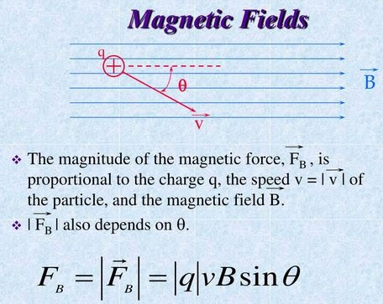
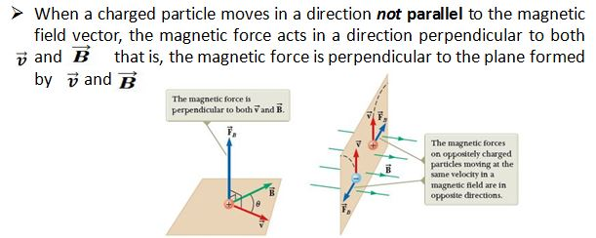
Magnetic field at a point in space
We also find the following results, which are totally different from those for experiments on electric forces:
The magnetic force is proportional to the speed v of the particle.
If the velocity vector makes an angle with the magnetic field, the magnitude of the magnetic force is proportional to sine of that angle
When a charged particle moves parallel to the magnetic field vector, the magnetic force on the charge is zero.

Slide 9
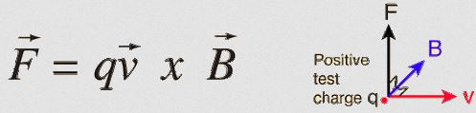
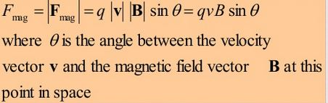
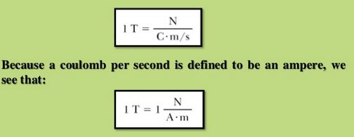
Magnetic field at a point in space
Despite this complicated behavior, these observations can be summarized in a compact way by writing the magnetic force in the form
By using the properties of cross product, the magnitude of magnetic force on a charged particle is
From Equation to the right side, we see that the SI unit of magnetic field is the Newton per coulomb-meter per second, which is called the tesla (T):

Slide 10
Let’s compare the important differences between the electric and magnetic versions of the particle in a field model:
• The electric force vector is along the direction of the electric field, whereas the magnetic force vector is perpendicular to the magnetic field.
• The electric force acts on a charged particle regardless of whether the particle is moving, whereas the magnetic force acts on a charged particle only when the particle is in motion.
• The electric force does work in displacing a charged particle, whereas the magnetic force associated with a steady magnetic field does no work when a particle is displaced because the force is perpendicular to the displacement of its point of application.
From the last statement and on the basis of the work–kinetic energy theorem, we conclude that the kinetic energy of a charged particle moving through a magnetic field cannot be altered by the magnetic field alone. The field can alter the direction of the velocity vector, but it cannot change the speed or kinetic energy of the particle.

Slide 11
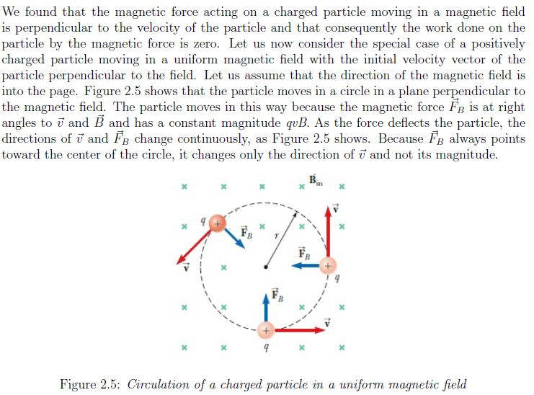
2.1.2. Motion of a Charged Particle in a Uniform Magnetic Field

Slide 12
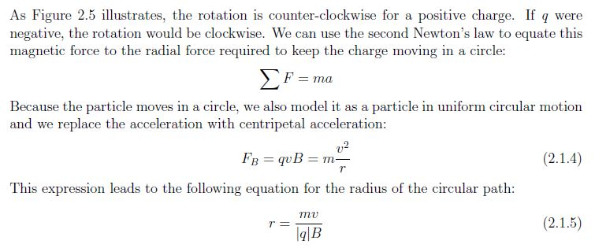
Motion of a Charged Particle in a Uniform Magnetic Field

Slide 13
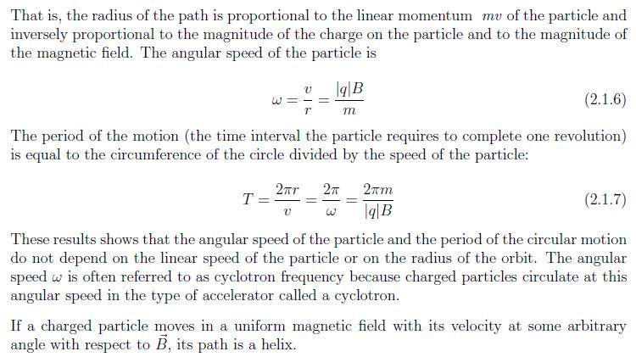
Motion of a Charged Particle in a Uniform Magnetic Field

Slide 14
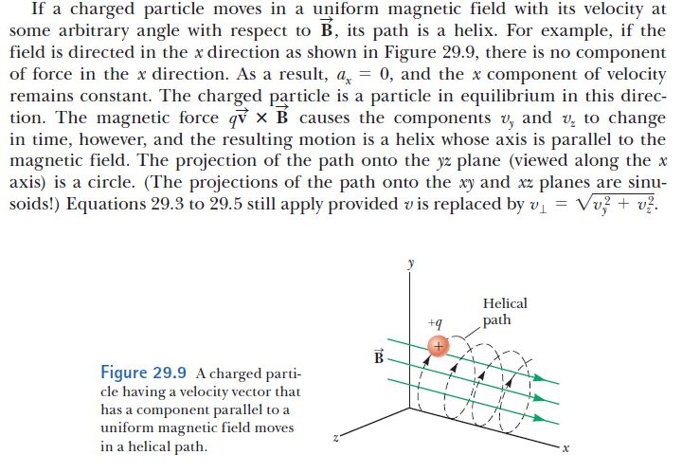
Motion of a Charged Particle in a Uniform Magnetic Field

Slide 15
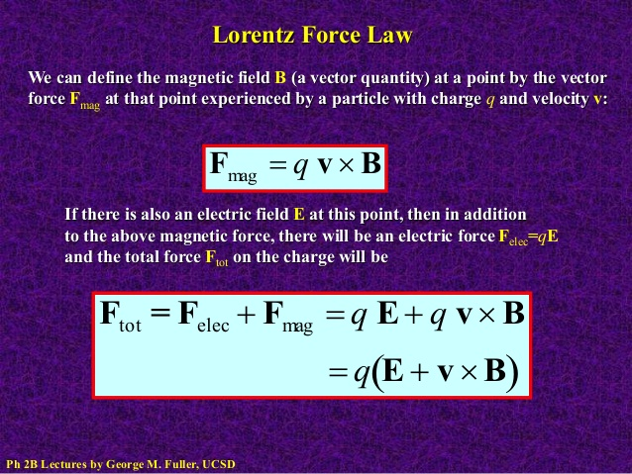

Slide 16
2.1.3. The Hall effect
When a current-carrying conductor is placed in a magnetic field, a potential difference is generated in a direction perpendicular to both the current and the magnetic field. This phenomenon, first observed by Edwin Hall in 1879, is known as the Hall Effect.
The arrangement for observing the Hall effect consists of a flat conductor carrying a current I in the x direction as shown in Figure 29.26. A uniform magnetic field is applied in the y direction. If the charge carriers are electrons moving in the negative x direction with a drift velocity they experience an upward magnetic force , a are deflected upward, and accumulate at the upper edge of the flat conductor, leaving an excess of positive charge at the lower edge. This accumulation of charge at the edges establishes an electric field in the conductor and increases until the electric force on carriers remaining in the bulk of the conductor balances the magnetic force acting on the carriers.

Slide 17
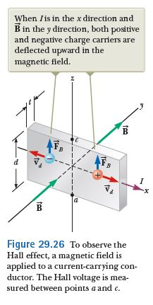
The Hall effect
The electrons can now be described by the particle in equilibrium model, and they are no longer deflected upward. A sensitive voltmeter connected across the sample can measure the potential difference, known as the Hall voltage , generated across the conductor.

Slide 18
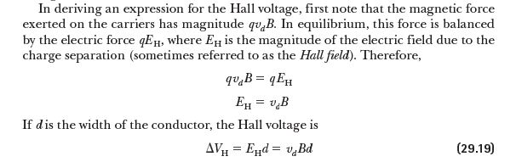
The Hall effect

Slide 19
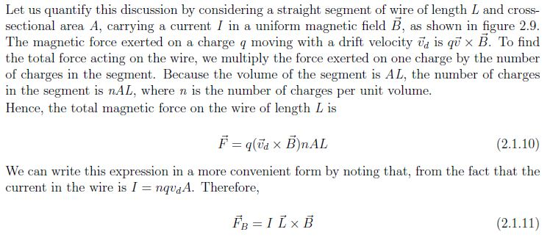
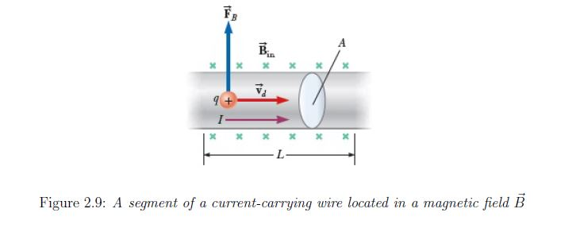
2.1.4 Magnetic Force acting on a Current-carrying conductor

Slide 20
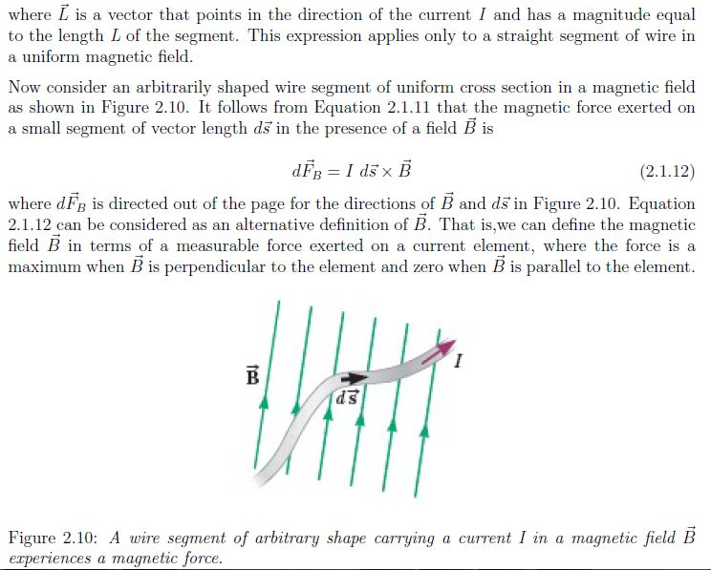

Slide 21
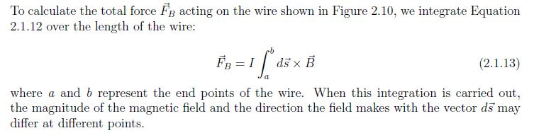

Slide 22
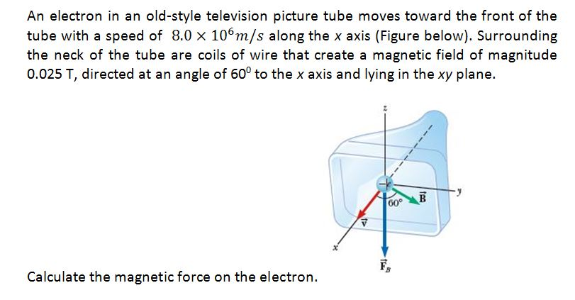
Example 1

Slide 23
Example 2
A proton is moving in a circular orbit of radius 14 cm in a uniform 0.35-T magnetic field perpendicular to the velocity of the proton. Find the speed of the proton.

Slide 24
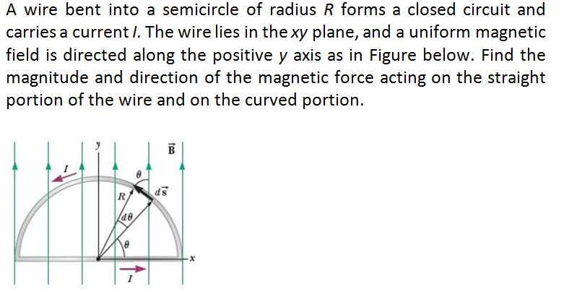
Example 3

Slide 25
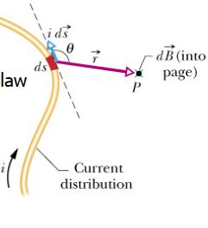

2.2 SOURCES OF THE MAGNETIC FIELDS
2.2.1 The Biot-Savart Law
Let a certain conductor be carrying a current ‘I’ in a direction shown on the figure. Let ‘P’ be the point where the magnetic field due to the wire is to be studied. Let a small portion be considered which is of length ‘ds’. Let the line joining ‘ds’ and point ‘P’ from an angle θ with the tangent to ‘ds’. Since the portion considered is very small, the magnetic field given by it at point P will also be small.

Slide 26
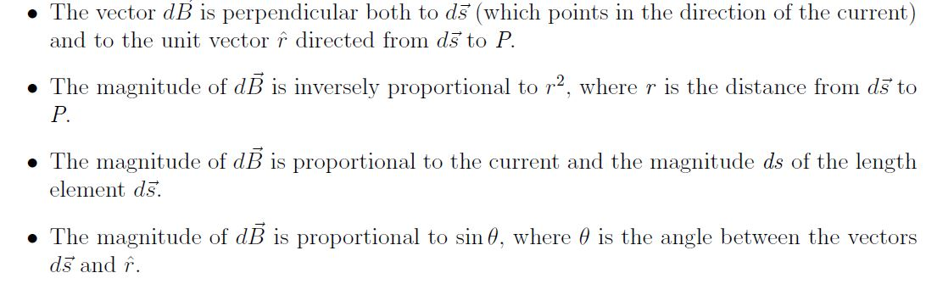
The Biot-Savart Law
By experimental observations and empirically also, dB is found to depend on several factors.

Slide 27
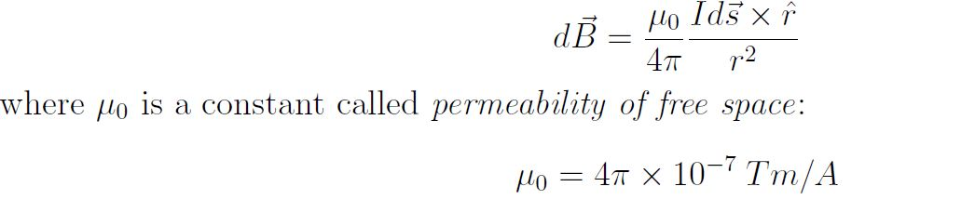
The Biot-Savart Law
These observations are summarized in the mathematical formula known today as the Biot-Savart law:

Slide 28
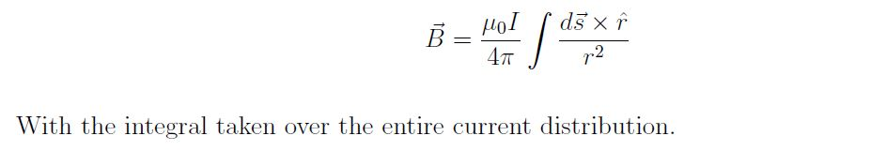
The Biot-Savart Law
The overall magnetic field will be equal to the sum of all these small magnetic fields.

Slide 29
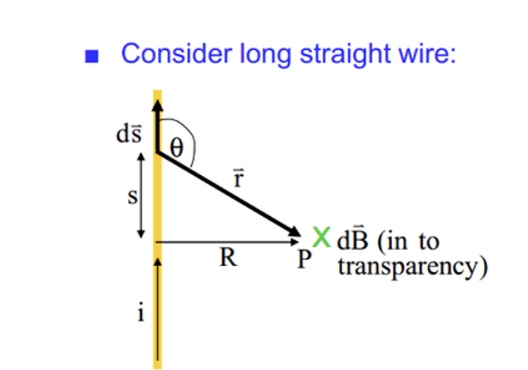
2.2.2. Magnetic Field Surrounding a Thin, Straight Conductor

Slide 30
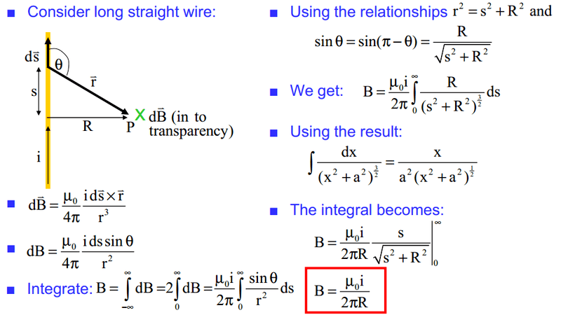
2.2.2. Magnetic Field Surrounding a Thin, Straight Conductor

Slide 31
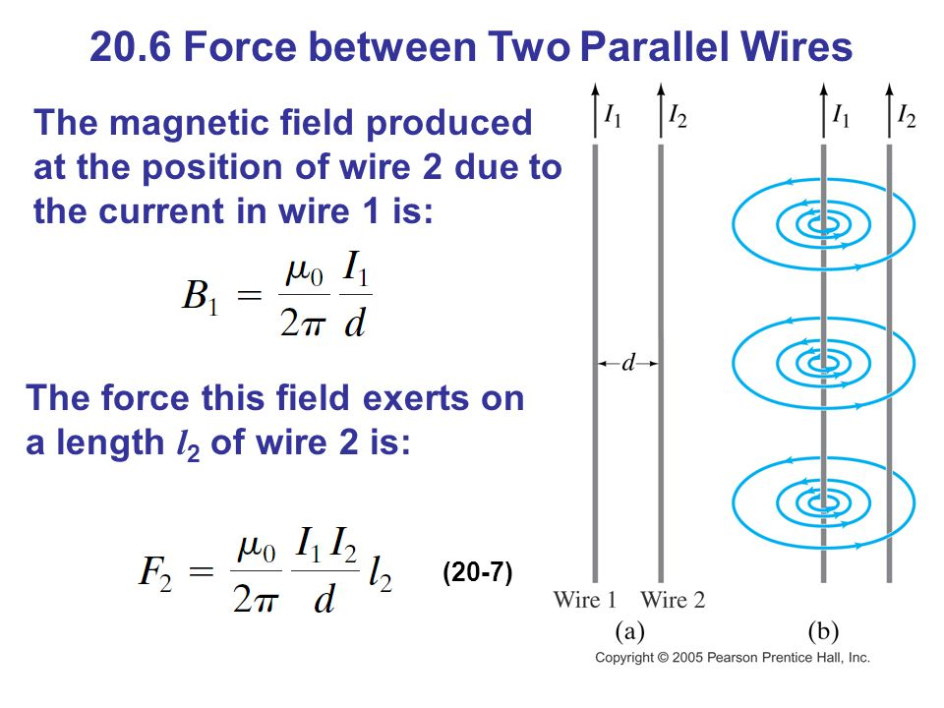

2.2.3 The Magnetic Force Between Two Parallel Conductors

Slide 32
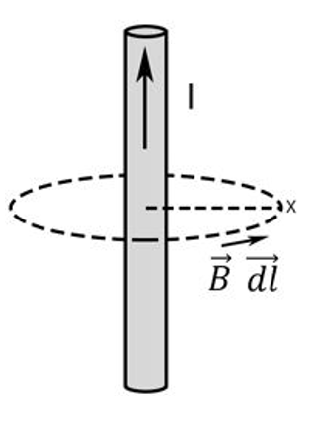
Ampere's Law
Ampere's Law states that for any closed loop path, the sum of the length elements times the magnetic field in the direction of the length element is equal to the permeability times the electric current enclosed in the loop.

Slide 33
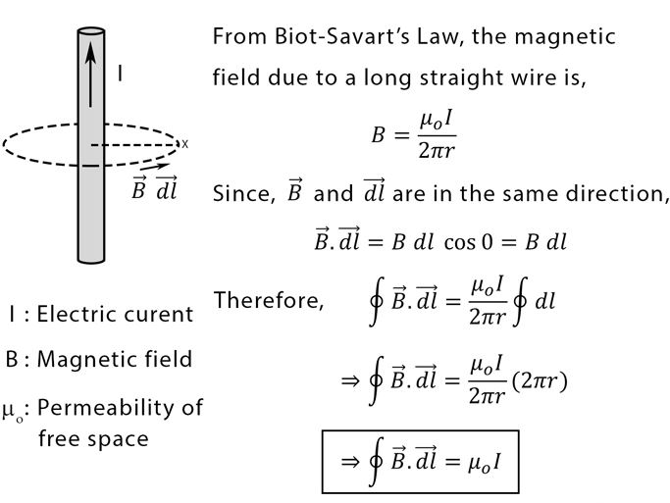
Ampere's Law
Ampere's Law states that for any closed loop path, the sum of the length elements times the magnetic field in the direction of the length element is equal to the permeability times the electric current enclosed in the loop.

Slide 34
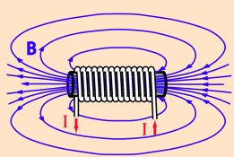

2.2.6. Ampere’s Law applications (The magnetic field inside the solenoid )

Slide 35

2.2.6. Ampere’s Law applications (The magnetic field inside the solenoid )
The magnetic field inside the solenoid is
Where
L- The length of the coil
I- Current in the coil
N- Number of turns (loops) in solenoid

Slide 36
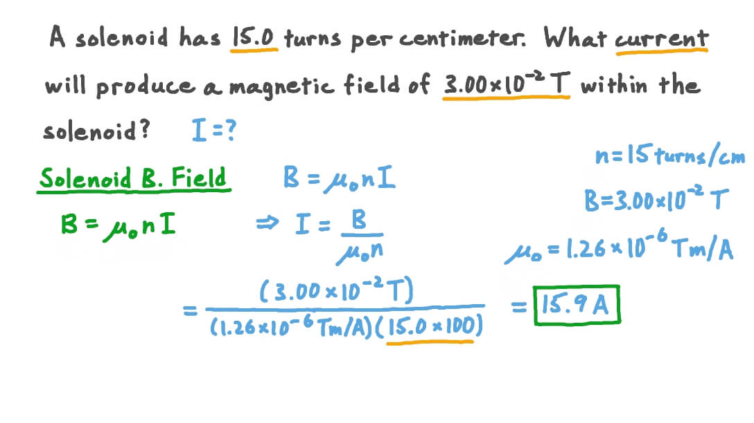
2.2.6. Ampere’s Law applications (The magnetic field inside the solenoid )
The magnetic field inside the solenoid is
Where
L- The length of the coil
I- Current in the coil
N- Number of turns (loops) in solenoid
Example

Slide 37
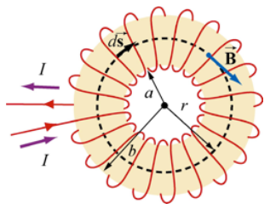
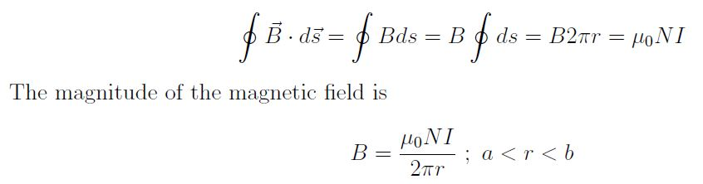
2.2.6. Ampere’s Law applications (The Magnetic Field of a Toroid (a circular solenoid))
Consider a toroid that consists of N turns, with inner radius a and outer radius b, as shown in Figure below. Find the magnetic field everywhere.

Slide 38
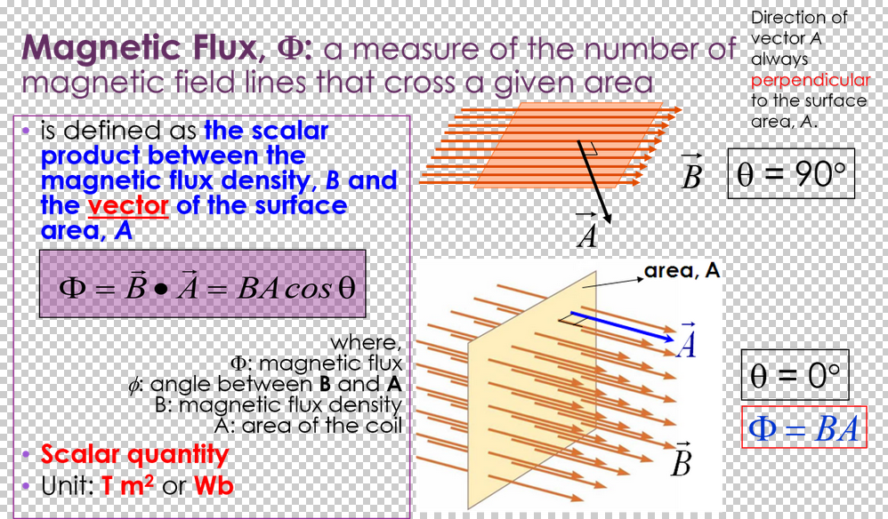
2.2.8 Magnetic Flux

Slide 39
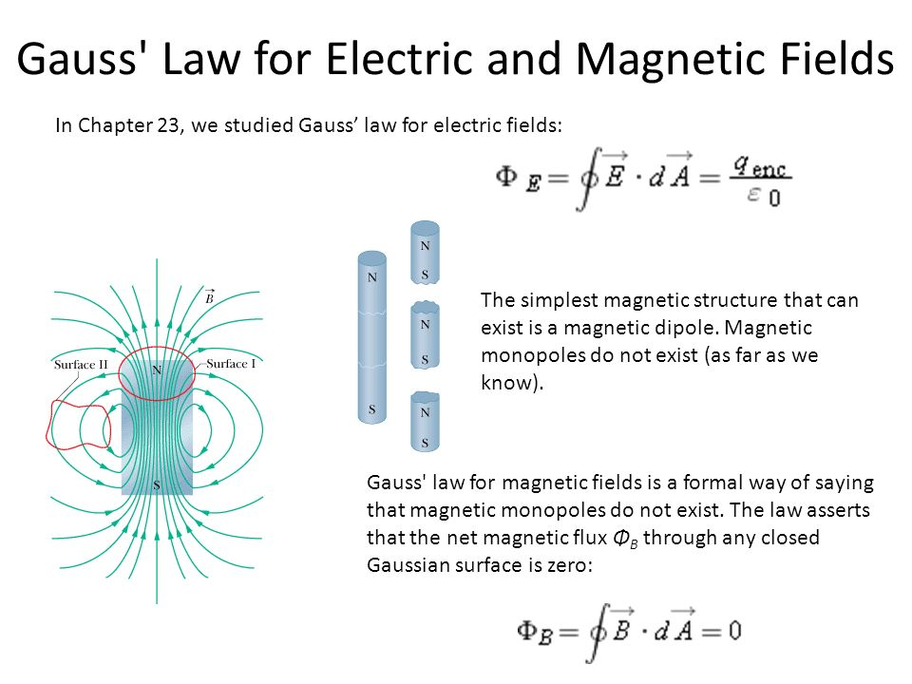
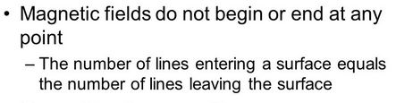
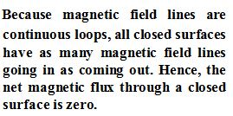

Slide 40
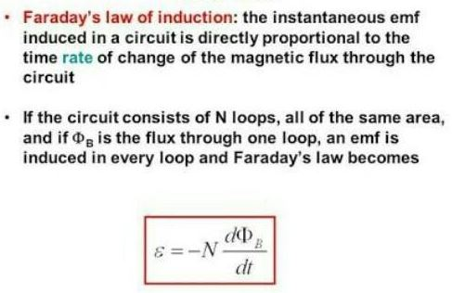

2.3. Faraday’s Law of induction

Slide 41

2.3. Faraday’s Law of induction

Slide 42
2.3. Faraday’s Law of induction
Definition:
Induced EMF, also known as electromagnetic induction or EMF Induction is the production of voltage in a coil because of the change in a magnetic flux through a coil.

Slide 43
LENZ LAW

Slide 44
LENZ LAW
“An induced current always flows in a direction such that it opposes the change which produced it”. See the figures below

Slide 45
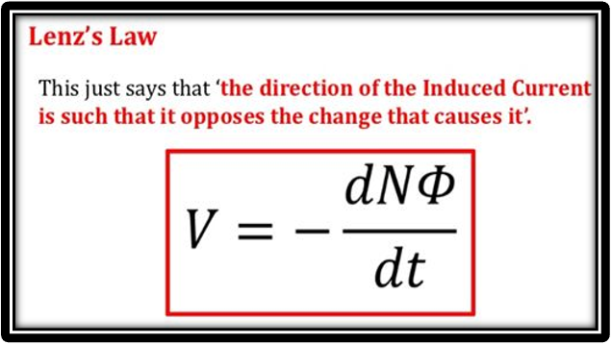
LENZ LAW
“An induced current always flows in a direction such that it opposes the change which produced it”. See the figures below

Slide 46

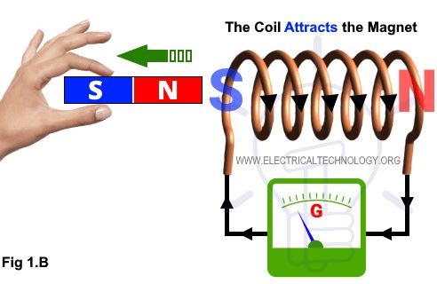
LENZ LAW
“An induced current always flows in a direction such that it opposes the change which produced it”. See the figures below

Slide 47

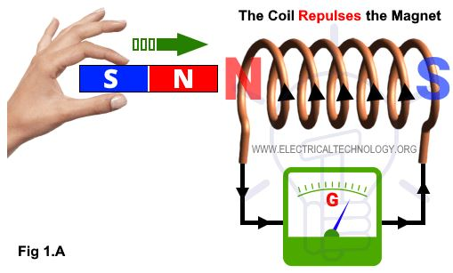
LENZ LAW
“An induced current always flows in a direction such that it opposes the change which produced it”. See the figures below

Slide 48

Self inductance

Slide 49
The inductance is measured in Henrys
Self inductance

Slide 50
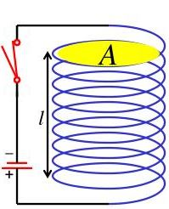
The inductance is measured in Henrys
Self inductance
Consider a solenoid of length l, area A and N turns, connected to a battery of emf ε (or E).
What happens as you close the switch?
Lenz Law– loops resists change in magnetic field
Magnetic field caused by the current
“Inductor” resists change in current

Slide 51

The inductance is measured in Henrys
Self inductance
Consider a solenoid of length l, area A and N turns, connected to a battery of emf ε (or E).
What happens as you close the switch?
Lenz Law– loops resists change in magnetic field
Magnetic field caused by the current
“Inductor” resists change in current

Slide 52
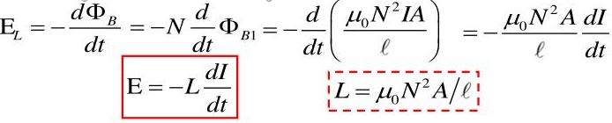
The inductance is measured in Henrys
Self inductance
Consider a solenoid of length l, area A and N turns, connected to a battery of emf ε (or E).
What happens as you close the switch?
Lenz Law– loops resists change in magnetic field
Magnetic field caused by the current
“Inductor” resists change in current

Slide 53
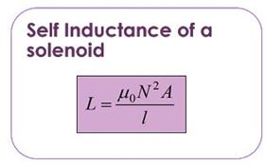
The inductance is measured in Henrys
Self inductance
Consider a solenoid of length l, area A and N turns, connected to a battery of emf ε (or E).
What happens as you close the switch?
Lenz Law– loops resists change in magnetic field
Magnetic field caused by the current
“Inductor” resists change in current

Slide 54
The inductance is measured in Henrys
Self inductance
Consider a solenoid of length l, area A and N turns, connected to a battery of emf ε (or E).
What happens as you close the switch?
Lenz Law– loops resists change in magnetic field
Magnetic field caused by the current
“Inductor” resists change in current
NB: The self-inductance of a toroid in the limit of l=2πa has the same form as that of a solenoid

Slide 55
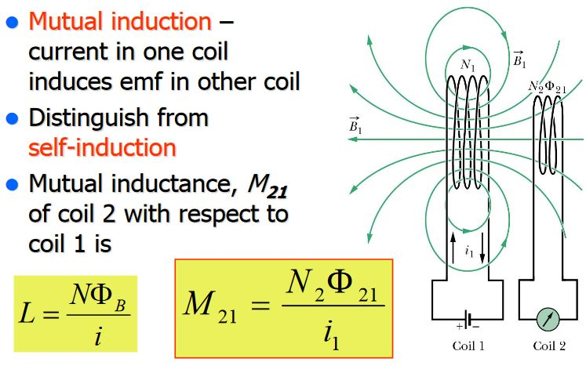
Mutual inductance

Slide 56
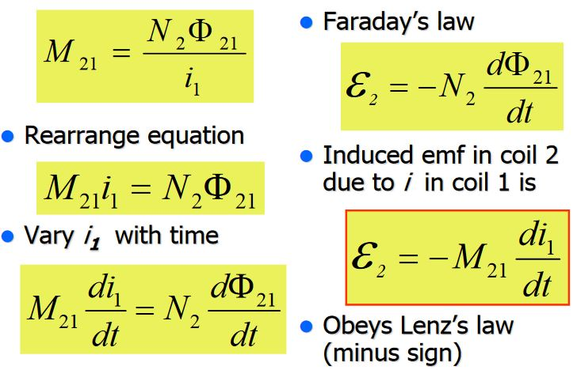
Mutual inductance

Slide 57
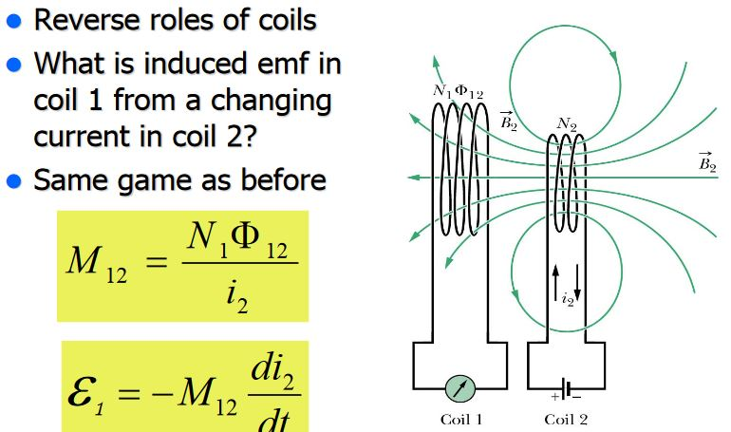
Mutual inductance

Slide 58
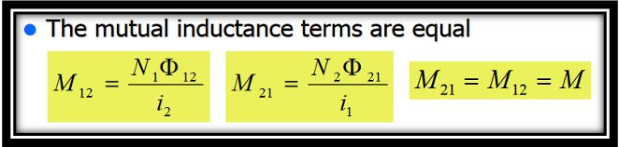
Mutual inductance

Slide 59
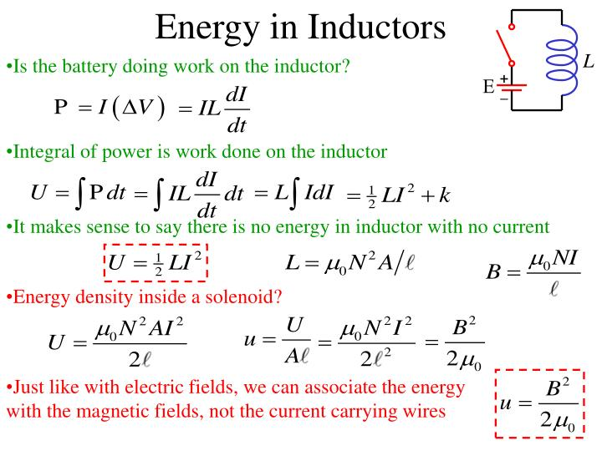

Slide 60
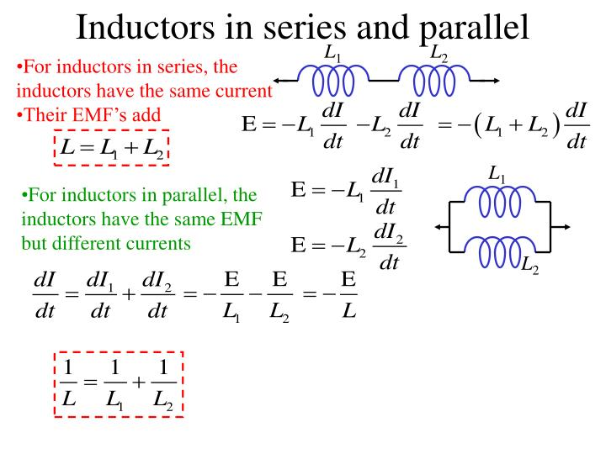

Slide 61


Slide 62



MAXWELL’S EQUATIONS

Slide 63

Example 4

Slide 64
Example 5
A coil consists of 200 turns of wire. Each turn is a square of side d= 18 cm, and a uniform magnetic field directed perpendicular to the plane of the coil is turned on. If the field changes linearly from 0 to 0.50 T in 0.80 s, what is the magnitude of the induced emf in the coil while the field is changing?

Slide 65


QUIZ 2

Slide 66

Example 6

Slide 67

Exercise1

Slide 68

Exercise2

Slide 69

Exercise3

Slide 70

Exercise4

Slide 71

Exercise5

Slide 72
END OF THE MODULE,
Good Luck In Your Exams

